Slide 1
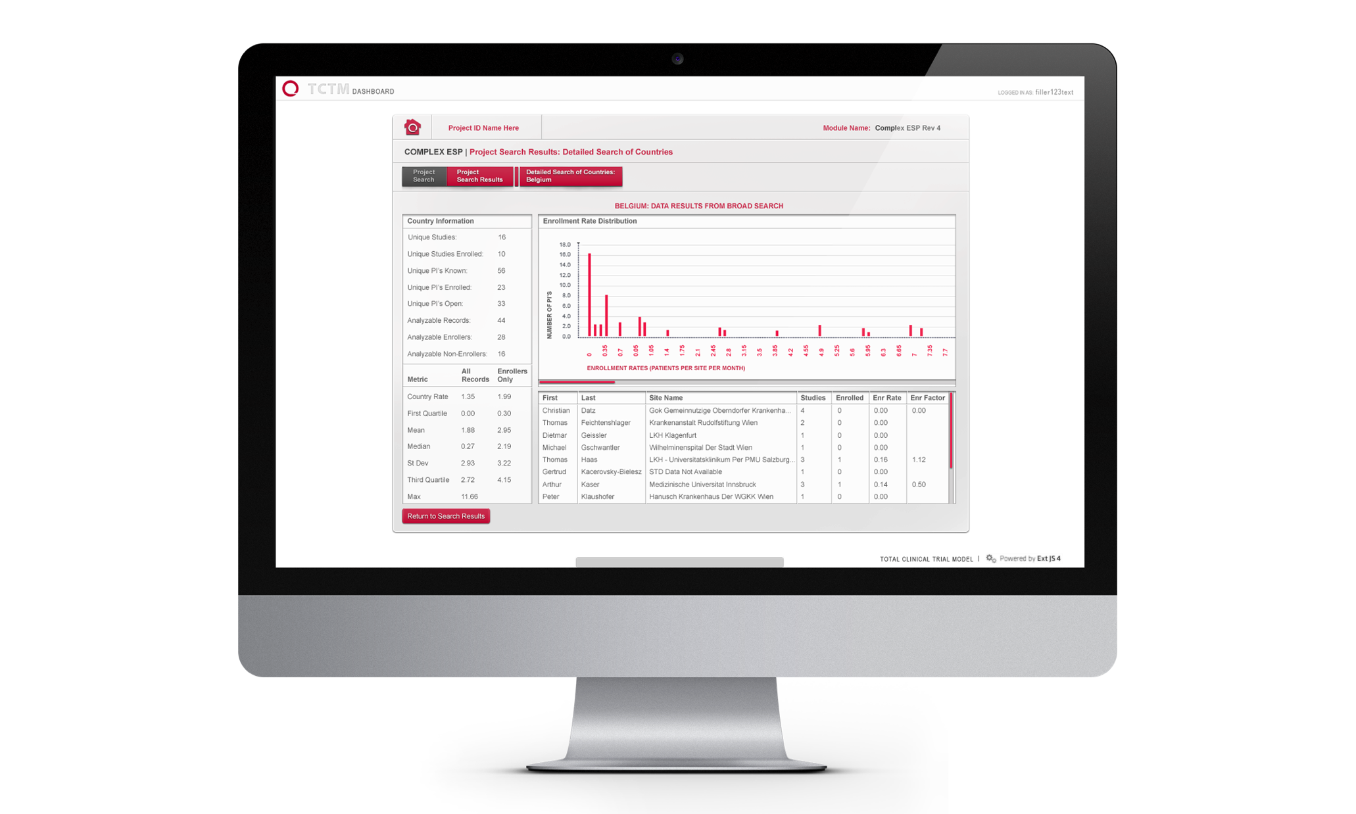
Heatcon – Dynamics CRM Redesign
Business Need
Heatcon Composite Systems is an international group of companies providing industry-leading equipment and services for advanced composite repairs and other industrial functions. Heatcon came to Affirma for consulting, design, implementation and ongoing support in redesigning their Dynamics CRM environment.
Scope of Partnership
Capturing business requirements across operating companies
Designing comprehensive CRM solution for Sales, Account Management, Customer Service and Engineering.
Epicor ERP Integration for full data flow of Customer Account Hierarchies, Orders, Invoicing, and Activities with Dynamics
CRM implementation, development, integration, deployment, training & end user change management.
Ongoing managed service support and CRM optimization.

